Slide 1




Making The Case for Compliance
Why you should invest in compliance today.

Slide 2


What is Regulatory Compliance?
Regulatory compliance in healthcare means adheringto federal and state lawsand regulations that apply to healthcare organizations and providers.
●
These regulations are intended to protect patients, safeguard sensitive information, prevent fraud, abuse and waste, and ensure high-quality care. Providers who do not take compliance seriously may find themselves under costly investigation by a government agency.
Compliance oversight is a required part of any healthcare business. Failure to create a compliant work environment could result in loss of accreditation, loss of Medicare certification and other government programs, and include significant fines, penalties, or even criminal penalties like
●
incarceration for key decision makers.

Slide 3


Compliance Pitfalls
Whatto Consider:
●
How are you allocating internal resources to handle compliance?
○ ○ ○
Is an existing employee handling it? Do you need to hire a new employee? Should you outsource instead?
● ● ● ●
How is risk assessment management addressed? Are employees trained annually? Have they agreed to follow your internal policies and procedures? How are you tracking and documenting compliance tasks? Have you standardized and organized your compliance efforts? Is it difficult to keep track of everything going on across multiple locations?

Slide 4


Increased Quality, Reduced Liability
Failure to commit to a culture of compliance will result in higher malpractice claims, and your organization's executives could even face personal liability lawsuits.
●
Providing quality care to patients and adhering to
regulatory standards will result in fewer malpractice
claims
When you go through a regulatory compliance
lawsuit or investigation, by training staff on
compliance best practices, you're protecting yourself
and your staff
If you’re found responsible for not training your staff
properly on compliance procedures, you could be
faced with penalties and fines
If you can prove that your company is otherwise
adhering to compliance requirements and training,
you can also see lower fines and smaller penalties
●
●
●

Slide 5


Increased Patient Satisfaction
Agoodcomplianceprogram createsastandardizedoperation, resulting in a better experience for your patients,
and improved outcomes for all.
Reduced Costs, Increased Profits
Operational efficienciesresultin reducedspend,andbetter patient experiences result in more returning patients,
better online reviews, and a more profitable business.
Recruiting Quality Staff
Recruiting todayisdifficult acrossallhealthcare roles. An organization that has fines and penalties against it will
experience a reputational hit - making recruitment even harder. Social media makes compliance deficiencies hard to contain, employee reviews on platforms such as Glassdoor can be negative based off poor training and experiences. A compliance program will reduce areas of turnover due to:
● ● ●
The lack of a code of conduct Unclear job descriptions Failure to follow governing standards

Slide 6



DOJ on Evaluating Compliance
The starting point:
●
●
How the company has identified, assessed,
and defined its risk profile
The degree to which the compliance
program devotes appropriate scrutiny and
resources to the spectrum of risks
Prosecutors should consider if the organization’s
compliance plan:
●
Is “designed to detect and prevent the particular
types of misconduct most likely to occur in a
corporation’s line of business”
“The effectiveness of the company’s risk
assessment and the manner in which the
company’s compliance program has been tailored
based on that risk assessment”
Whether its criteria is “periodically updated”
●
●

Slide 7


“Prosecutors are instructed to probe specifically whether a compliance program is a 'paper program' or one 'implemented, reviewed, and
revised, as appropriate, in an effective manner.”

Slide 8



Department of Justice
YatesMemoHoldsIndividuals
Accountable
In order for a company to receive any consideration for cooperation under the Principles of Federal Prosecution of Business Organizations, the company must completely disclose to the Department all relevant facts about individual misconduct. Consistent with this requirement, DOJ policy requires that a company “identify all individuals involved in or responsible for the misconduct” as a prerequisite to receiving any cooperation credit.

Slide 9



What’s it Mean for the Board?
Boards of Directors are also coming under scrutiny and courts are showing a trend in holding board members responsible if they "should have known" about non-compliant behavior.
5-Year Corporate Integrity Agreement (CIA)
A noncompliant organization may be required to enter into a CIA “…the Board shall retain an individual or entity with expertise in
compliance with Federal health care program requirements (Compliance
Expert) to perform a review of the effectiveness of NAHC’s Compliance
Program.”
Obligations for Healthcare Directors
Private equity-backed healthcare has been on the radar of several government enforcement agencies for nearly 15 years. The U.S. Department of Health and Human Services Office of the Inspector General (OIG) documented their awareness of the increase private equity investment in the healthcare industry in SNIF work plans as early as 2009.

Slide 10


Compliance Enforcement
Department of Health enforcement in 2022 recovered $2.2B
●
2023 anticipated to bring more government actions and robust enforcement efforts
False Claims Act Civil Litigation Success
●
2021 DOJ collects 2nd largest return from civil fraud cases - $5.6B
○
150% increase from False Claims Act recoveries in prior year 2nd time since 1995 Government initiated non-gui tam matters.
○
●
Of the $5.6B, $5B relates to the healthcare industry
○
Additional funds recovered for state Medicaid programs
●
$70B since Congress’ revamp of the False Claims Act in 1986. Recoveries and fines are part of the government budget

Slide 11


Fines on the Rise
Of the $2.2 billion in False Claims Act settlements in 2022,
over
$1.7 billion
was related to matters involved in the
healthcare industry.
more than 809
The DOJ opened
new criminal
healthcare fraud investigations and
more than 477
healthcarefraud
defendants were convicted of
related crimes during 2022.
5 years
Medical clinic owner in Miami was sentenced to
in prison for submitting $40 million in false claims to
Unitedhealthcare and Blue Cross Blue Shield. They were also
ordered to forfeit $8 million, four real estate
properties, and luxury vehicles.

Slide 12





“EEG Testing and Private Companies Pay $15.3 Million to Resolve Kickback and False Billing Allegations”
“Private Equity Firms Must Face Whistleblower’s PPP Fraud Suit”
“Private Equity Firm and Former Health Centers Executives Pay $25 Million Over Alleged False Claims Submitted for Unlicensed and Unsupervised Patient Care”
“Healthcare Executives Sentenced to Prison for Fraud LA Care, the Largest Publicly Operated Health Plan in the
“Justice Department Charges Dozens for $1.2 Billion in Healthcare Fraud”
Country Paid $1,300,000”
“The $16 Million Settlement Stems from a Series of Attacks in 2014 and 2015 that Potentially Exposed the Electronic Health Information of....”

Slide 13



The ROI of Compliance
Compliance spans an entire organization.
Compliance isn’t a department inside an
organization, it is a partner to every strategic, growth
and revenue-driving initiative.
●
Smart compliance programs protect revenue
by ensuring the right practices are executed in
the right ways, thus minimizing risk
The value of compliance is the impact of a loss
not recognized. Clinical compliance prevents
medical malpractice lawsuits, just as properly
credentialing providers ensures excellence in
care, following proper policy and procedure for
coding prevents overbilling and paybacks
Compliance manages risk and prevents loss to
an organization
●
●

Slide 14



Technology and Compliance
The right technology solution should provide the compliance team with a meaningful dashboard so efforts can be disseminated to key stakeholders to show the value of the investment in compliance.
The compliance team should:
●
Have a platform for tracking work plan progress and compliance initiatives in order to report in a meaningful way to the board Identify meaningful key performance indicators for the organization and use technology to track and analyze the data
Using the KPIs and reporting mechanisms, the compliance team can tie compliance efforts to key company goals and initiatives, giving compliance a meaningful seat at the
●
table.

Slide 15
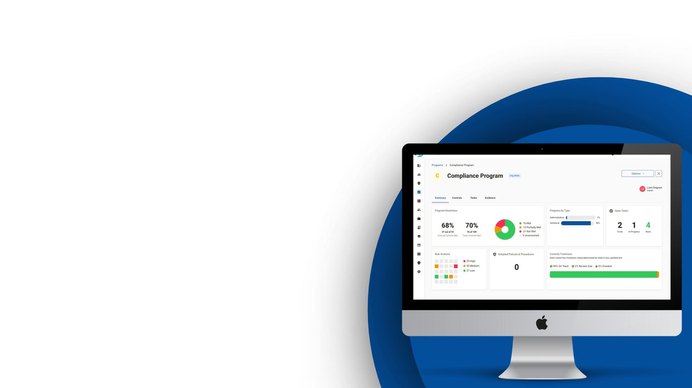


Compliancy Group’s Software
Compliancy Group’s software simplifies the tracking of compliance efforts that prove effective compliance – ultimately providing a defense, and protection.
Effective compliance should cover the entire
organization – the software keeps compliance
efforts organized, supports planning and execution,
audits and monitoring – thus mitigating risk.
All compliance work serves to support and
protect the profitability of the company.
Utilization of a software solution not only
reduces the risk on non-compliance, but also
streamlines the process which ultimately
reduces the number of FTEs required to
oversee the ever-changing compliance rules
and regulations.

Slide 16
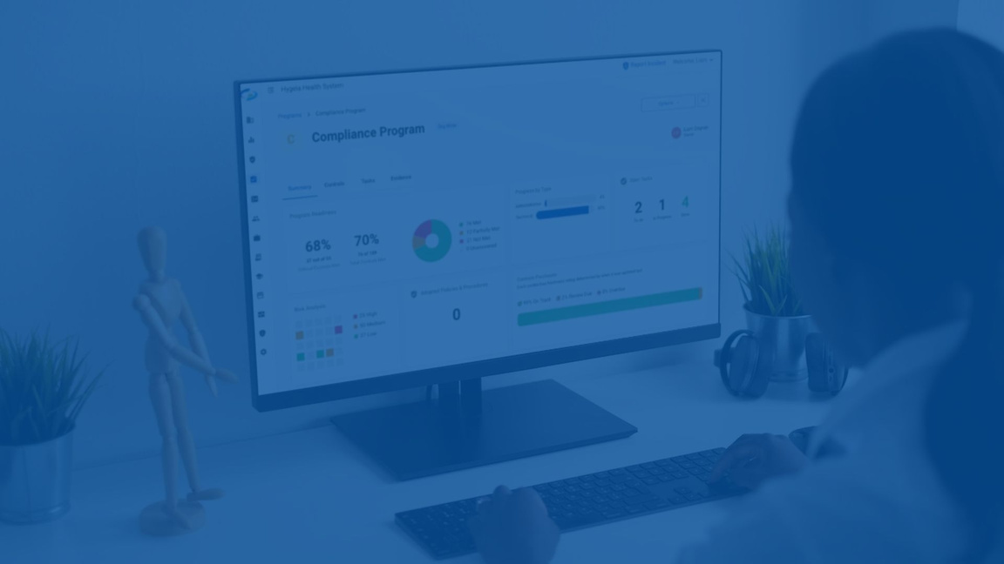


Assess & Manage Risk
Policies
Risk Assessments
Corrective Action Plans
Incident
Vendor
and
Training
Procedures
Management
Management
Compliance Training & Management
● ●
Easilytrainstaffacrossmultiple locations,while trackingindividual progress
Support your Compliance Officer by keeping the work plan on track - triggering due
dates, organizing documents, and tracking incidents

Slide 17




Document Management & Compliance Reporting
● ● ● ●
Templated documents or upload your own Organize and access all compliance documents in one place Pre-configured reporting templates make effective reporting simple Includes advanced scheduling and snapshot options to meet your compliance objectives
Increased Efficiency
● ● ●
92% more efficient Automated process with real time updates Live status updates vs manual or annual process
“Compliancy Group’s software is exactly the answer I was looking for to create and manage my policies and procedures. Working with them saved me at least three years of work”
- Clive Wilby, Compliance Officer, Alabama Cancer Centers.

Slide 18


Client Success Story
Who: Compliance Officer for a mid-market business, Alabama Cancer Center What: After completing the SRA fully realized the extent of their remediation needs. Using Compliancy Group, he was able to save three years of work, didn’t have to hire additional staff to keep tabs on his ongoing compliance, and had employee training assigned without hassle. Outcome: With his purchase of Compliancy Group’s software, ACC was able to confidently complete all necessary steps for HIPAA compliance. They were able to save time and money, and are able to sleep better at night knowing that the organization has a plan in place.
The big thing is, ‘hey, do you want to get on the wrong side of HIPAA?’ or can you have a system that interjects? So you, as CEO or Financial Manager, you can sleep a little better knowing that there’s something in place.” -Alabama Cancer Center

Slide 19






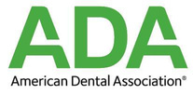
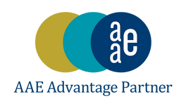



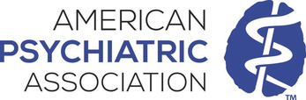

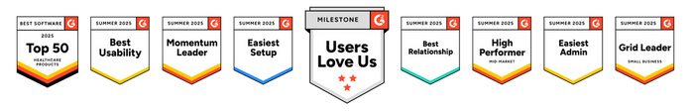

Need Help Tracking and Managing Your Compliance? Contact Compliancy Group Today!
info@compliancygroup.com
(929) 492-2234
compliancygroup.com
Compliancy Group is Proud Partners of

